Slide 1
Math 5364 Notes Chapter 5: Alternative Classification Techniques
Jesse Crawford
Department of Mathematics
Tarleton State University

Slide 2
Today's Topics
The k-Nearest Neighbors Algorithm
Methods for Standardizing Data in R
The class package, knn, and knn.cv

Slide 3
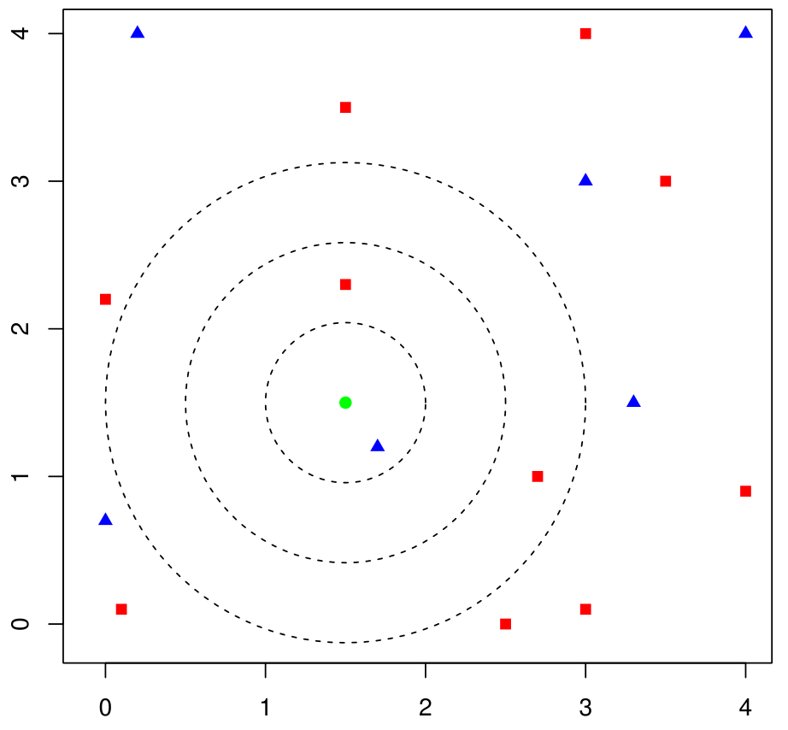
k-Nearest Neighbors
Divide data into training and test data.
For each record in the test data
Find the k closest training records
Find the most frequently occurring class label among them
The test record is classified into that category
Ties are broken at random
Example
If k = 1, classify green point as p
If k = 3, classify green point as n
If k = 2, classify green point as p or n (chosen randomly)

Slide 4
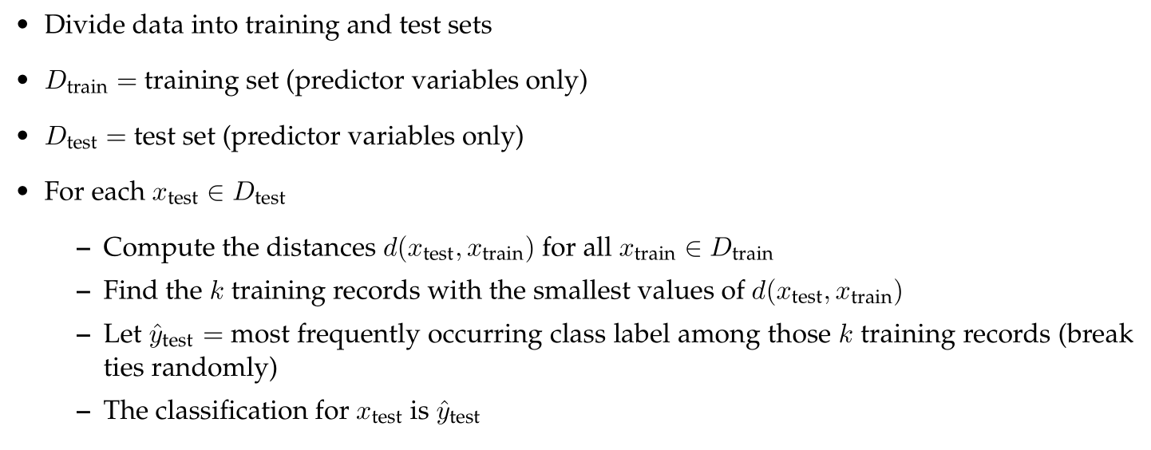
k-Nearest Neighbors Algorithm
Algorithm depends on a distance metric d

Slide 5
Euclidean Distance Metric
Example 1
x = (percentile rank, SAT)
x₁ = (90, 1300)
x₂ = (85, 1200)
d(x_{1,} x₂) = 100.12
Example 2
x₁ = (70, 950)
x₂ = (40, 880)
d(x_{1,} x₂) = 76.16
Euclidean distance is sensitive to measurement scales.
Need to standardize variables!

Slide 6
Standardizing Variables
mean percentile rank = 67.04
st dev percentile rank = 18.61
mean SAT = 978.21
st dev SAT = 132.35
Example 1
x = (percentile rank, SAT)
x₁ = (90, 1300)
x₂ = (85, 1200)
z₁ = (1.23, 2.43)
z₂ = (0.97, 1.68)
d(z_{1,} z₂) = 0.80
Example 2
x₁ = (70, 950)
x₂ = (40, 880)
z₁ = (0.16, -0.21)
z₂ = (-1.45, -0.74)
d(z_{1,} z₂) = 1.70

Slide 7
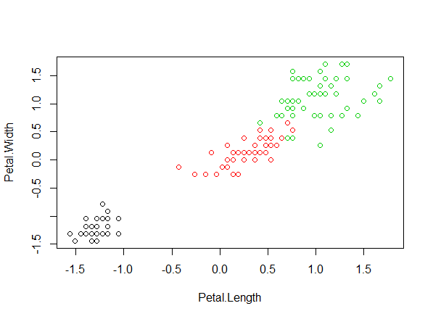
Standardizing iris Data
x=iris[,1:4]
xbar=apply(x,2,mean)
xbarMatrix=cbind(rep(1,150))%*%xbar
s=apply(x,2,sd)
sMatrix=cbind(rep(1,150))%*%s
z=(x-xbarMatrix)/sMatrix
apply(z,2,mean)
apply(z,2,sd)
plot(z[,3:4],col=iris$Species)

Slide 8
Another Way to Split Data
#Split iris into 70% training and 30% test data.
set.seed=5364
train=sample(nrow(z),nrow(z)*.7)
z[train,] #This is the training data
z[-train,] #This is the test data

Slide 9
The class Package and knn Function
library(class)
Species=iris$Species
predSpecies=knn(train=z[train,],test=z[-train,],cl=Species[train],k=3)
confmatrix(Species[-train],predSpecies)
Accuracy = 93.33%

Slide 10
Leave-one-out CV with knn
predSpecies=knn.cv(train=z,cl=Species,k=3)
confmatrix(Species,predSpecies)
CV estimate for accuracy is 94.67%

Slide 11
Optimizing k with knn.cv
accvect=1:10
for(k in 1:10){
predSpecies=knn.cv(train=z,cl=Species,k=k)
accvect[k]=confmatrix(Species,predSpecies)$accuracy
}
which.max(accvect)
For binary classification problems, odd values of k avoid ties.

Slide 12
General Comments about k
Smaller values of k result in greater model complexity.
If k is too small, model is sensitive to noise.
If k is too large, many records will start to be classified simply into the most frequent class.

Slide 13
Today's Topics
Weighted k-Nearest Neighbors Algorithm
Kernels
The kknn package
Minkowski Distance Metric

Slide 14
Indicator Functions

Slide 15
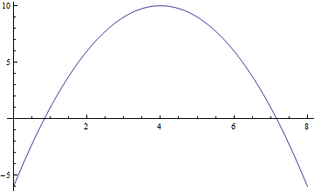
max and argmax

Slide 16
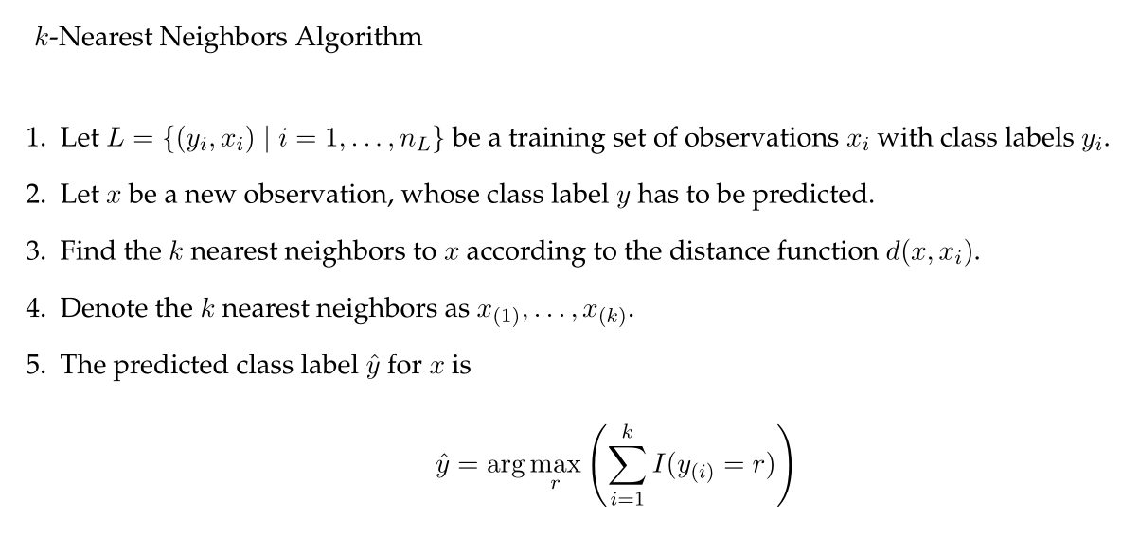
k-Nearest Neighbors Algorithm

Slide 17
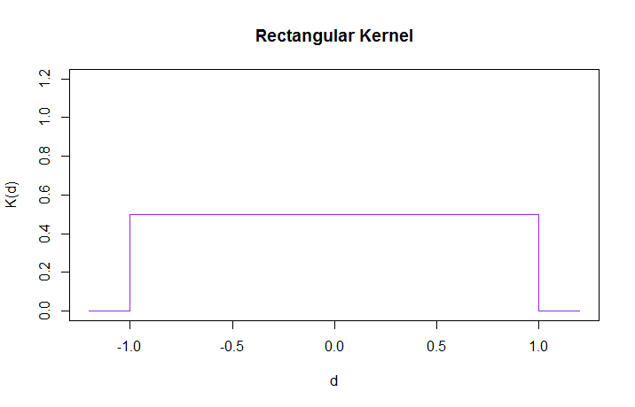
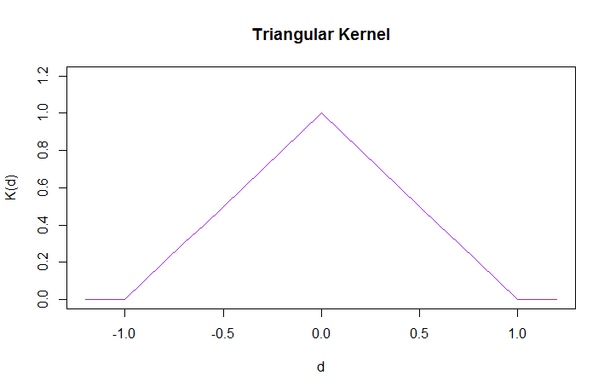
Kernel Functions

Slide 18
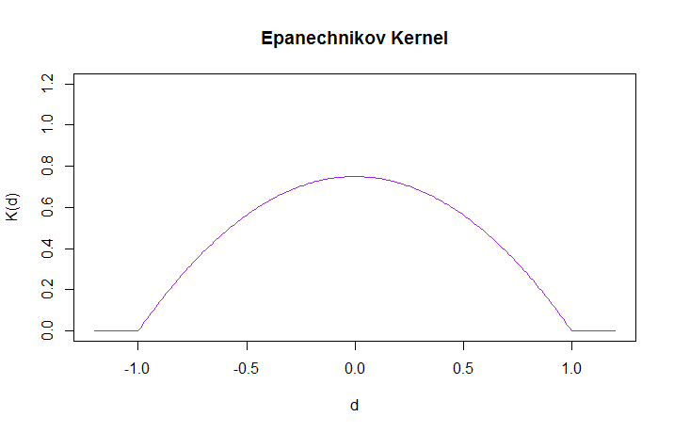
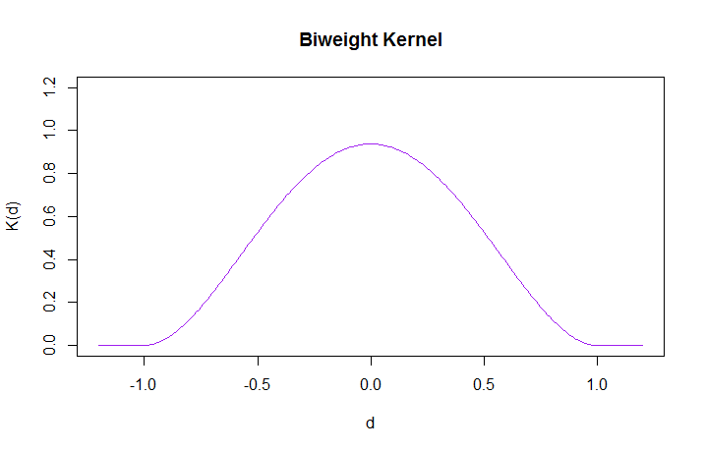
Kernel Functions

Slide 19
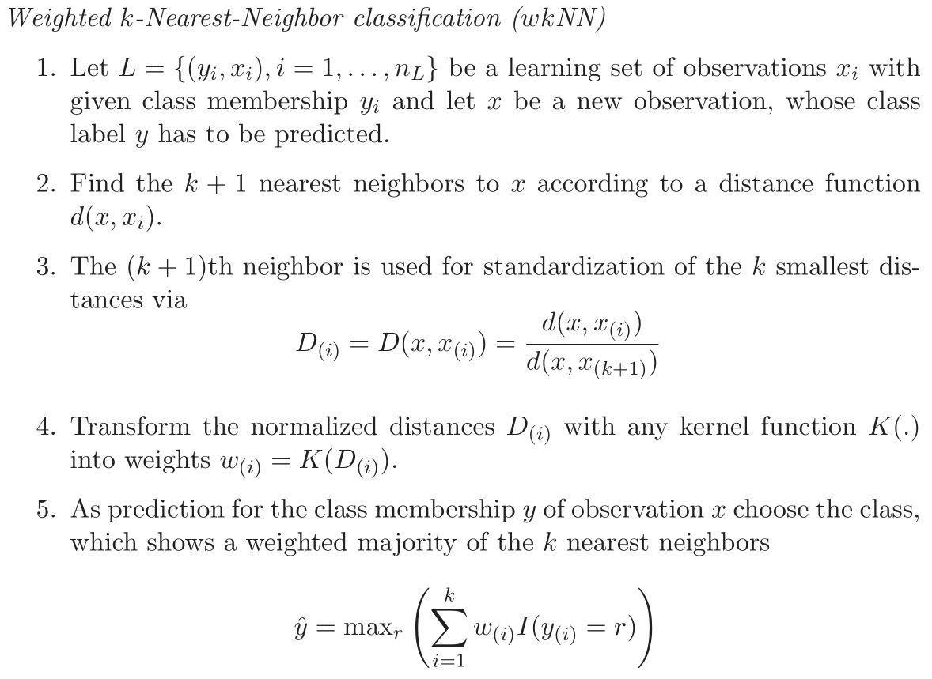
Weighted k-Nearest Neighbors

Slide 20
kknn Package
train.kknn uses leave-one-out cross-validation to optimize k and the kernel
kknn gives predictions for a specific choice of k and kernel (see R script)
R Documentation
http://cran.r-project.org/web/packages/kknn/kknn.pdf
Hechenbichler, K. and Schliep, K.P. (2004) "Weighted k-Nearest-Neighbor Techniques and Ordinal Classification".
http://epub.ub.uni-muenchen.de/1769/1/paper_399.pdf

Slide 21
Minkowski Distance Metric
Euclidean distance is
Minkowski distance with q = 2

Slide 22
Today's Topics
Naïve Bayes Classification

Slide 23
HouseVotes84 Data
Want to calculate
P(Y = Republican | X₁ = no, X₂ = yes, …, X₁₆ = yes)
Possible Method
Look at all records where X₁ = no, X₂ = yes, …., X₁₆ = yes
Calculate the proportion of those records with Y = Republican
Problem: There are 2¹⁶ = 65,536 combinations of X_{j}'s, but only 435 records
Possible solution: Use Bayes' Theorem

Slide 24
Setting for Naïve Bayes
p.m.f. for Y
Prior distribution for Y
Joint conditional distribution
of X_{j}'s given Y
Conditional distribution of X_{j} given Y
Assumption:
X_{j}'s are conditionally independent given Y

Slide 25
Bayes' Theorem

Slide 26
Posterior
Probability
Prior
Probabilities
Conditional
Probabilities
How can we estimate prior probabilities?

Slide 27
Posterior
Probability
Prior
Probabilities
Conditional
Probabilities
How can we estimate conditional probabilities?

Slide 28
Posterior
Probability
Prior
Probabilities
Conditional
Probabilities
How can we calculate posterior probabilities?

Slide 29
Naïve Bayes Classification

Slide 30
Naïve Bayes with Quantitative Predictors

Slide 31
Testing Normality
qq Plots
Straight line: evidence of normality
Deviates from straight line: evidence against normality

Slide 32
Naïve Bayes with Quantitative Predictors
Option 2: Discretize predictor variables using cut function.
(convert variable into a categorical variables by breaking into bins)

Slide 33
Today's Topics
The Class Imbalance Problem
Sensitivity, Specificity, Precision, and Recall
Tuning probability thresholds

Slide 34
Class Imbalance Problem
Class Imbalance: One class is much less frequent than the other
Rare class: Presence of an anomaly (fraud, disease, loan default, flight delay, defective product).
+ Anomaly is present
- Anomaly is absent
Confusion Matrix |  | Predicted Class
 |  | + | -
Actual Class | + | f₊₊ | f₊₋
 | - | f₋₊ | f₋₋

Slide 35
Confusion Matrix |  | Predicted Class
 |  | + | -
Actual Class | + | f₊₊ (TP) | f₊₋ (FN)
 | - | f₋₊ (FP) | f₋₋ (TN)
TP = True Positive
FP = False Positive
TN = True Negative
FN = False Negative

Slide 36
Confusion Matrix |  | Predicted Class
 |  | + | -
Actual Class | + | f₊₊ (TP) | f₊₋ (FN)
 | - | f₋₊ (FP) | f₋₋ (TN)
TP = True Positive
FP = False Positive
TN = True Negative
FN = False Negative

Slide 37
Confusion Matrix |  | Predicted Class
 |  | + | -
Actual Class | + | f₊₊ (TP) | f₊₋ (FN)
 | - | f₋₊ (FP) | f₋₋ (TN)
TP = True Positive
FP = False Positive
TN = True Negative
FN = False Negative

Slide 38
Confusion Matrix |  | Predicted Class
 |  | + | -
Actual Class | + | f₊₊ (TP) | f₊₋ (FN)
 | - | f₋₊ (FP) | f₋₋ (TN)
TP = True Positive
FP = False Positive
TN = True Negative
FN = False Negative

Slide 39
F₁ is the harmonic mean of p and r
Large values of F₁ ensure reasonably large values of p and r

Slide 41
Probability Threshold

Slide 42
Probability Threshold

Slide 43
Probability Threshold
We can modify the probability threshold p₀
to optimize performance metrics

Slide 44
Today's Topics
Receiver Operating Curves (ROC)
Cost Sensitive Learning
Oversampling and Undersampling

Slide 45
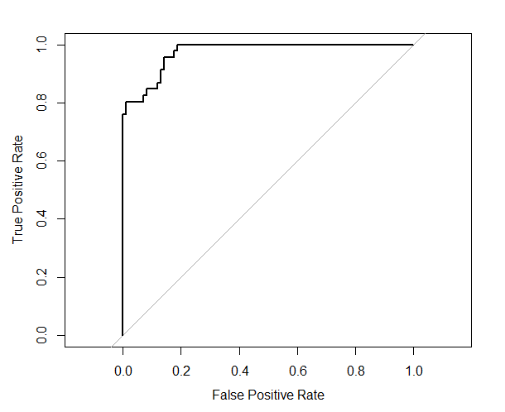
Receiver Operating Curves (ROC)
Plot of True Positive Rate vs False Positive Rate
Plot of Sensitivity vs 1 – Specificity
AUC = Area under curve

Slide 46
AUC is a measure of model discrimination
How good is the model at discriminating between +'s and –'s

Slide 47
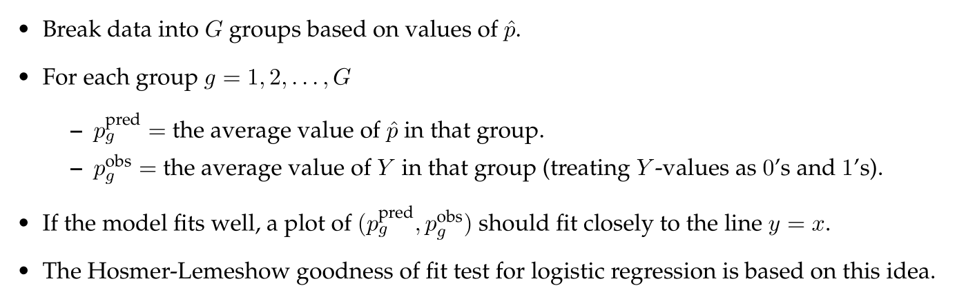

Slide 48
Cost Sensitive Learning
Confusion Matrix |  | Predicted Class
 |  | + | -
Actual Class | + | f₊₊ (TP) | f₊₋ (FN)
 | - | f₋₊ (FP) | f₋₋ (TN)

Slide 49
Example: Flight Delays
Confusion Matrix |  | Predicted Class
 |  | Delay + | Ontime -
Actual Class | Delay + | f₊₊ (TP) | f₊₋ (FN)
 | Ontime - | f₋₊ (FP) | f₋₋ (TN)

Slide 52
Undersampling and Oversampling
Split training data into cases with Y = + and Y = -
Take a random sample with replacement from each group
Combine samples together to create new training set
Undersampling: decreasing frequency of one of the groups
Oversampling: increasing frequency of one of the groups

Slide 53
Today's Topics
Support Vector Machines

Slide 54
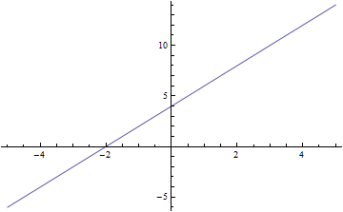
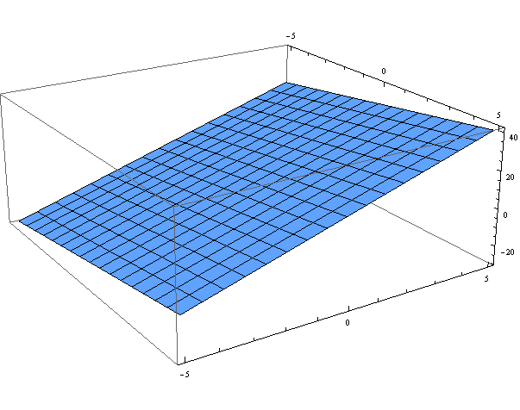
Hyperplanes

Slide 55
Equation of a Hyperplane

Slide 56
Rank-nullity Theorem

Slide 57
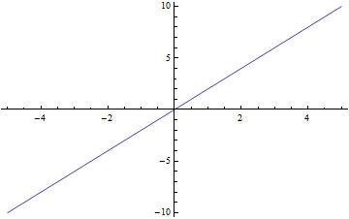

Slide 58
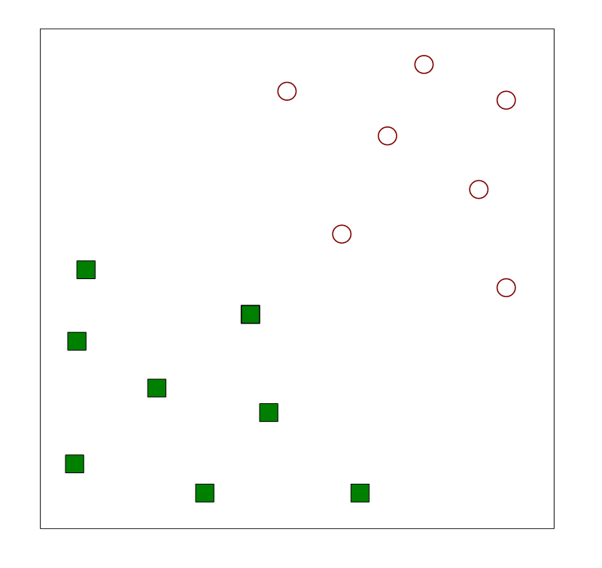
Support Vector Machines
Goal: Separate different classes
with a hyperplane

Slide 59
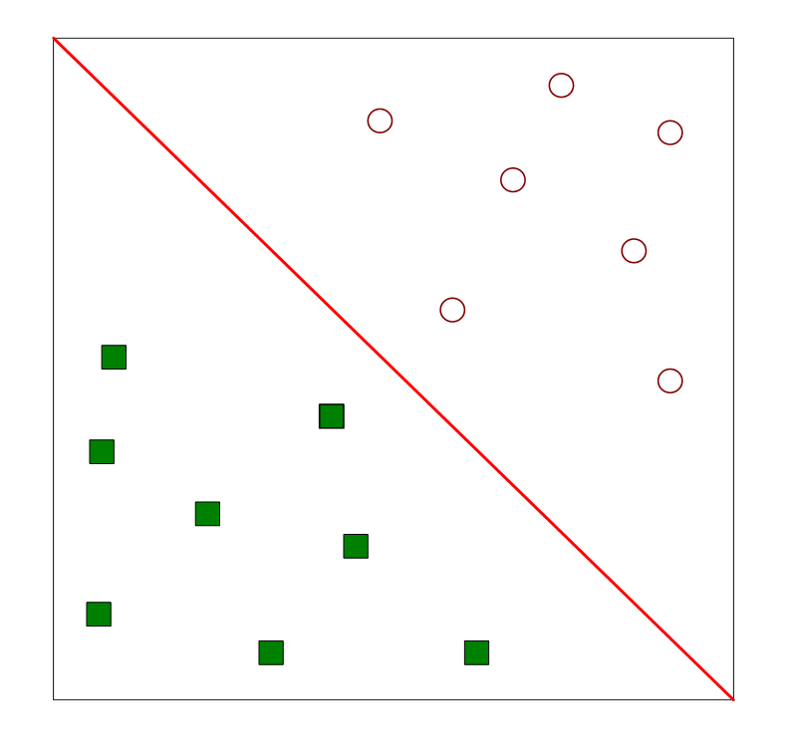
Support Vector Machines
Goal: Separate different classes
with a hyperplane
Here, it's possible
This is a linearly separable problem

Slide 60
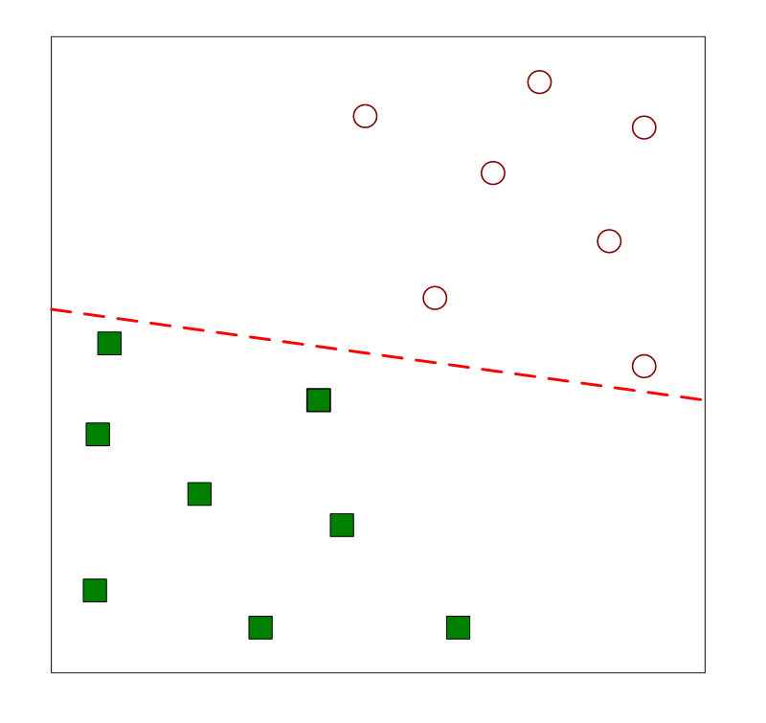
Support Vector Machines
Another hyperplane that works

Slide 61
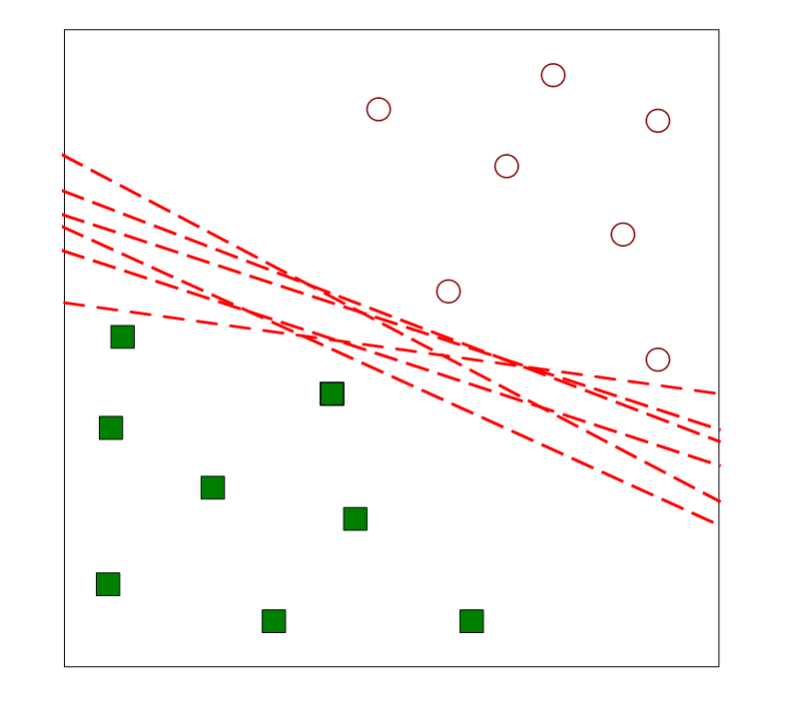
Support Vector Machines
Many possible hyperplanes

Slide 62
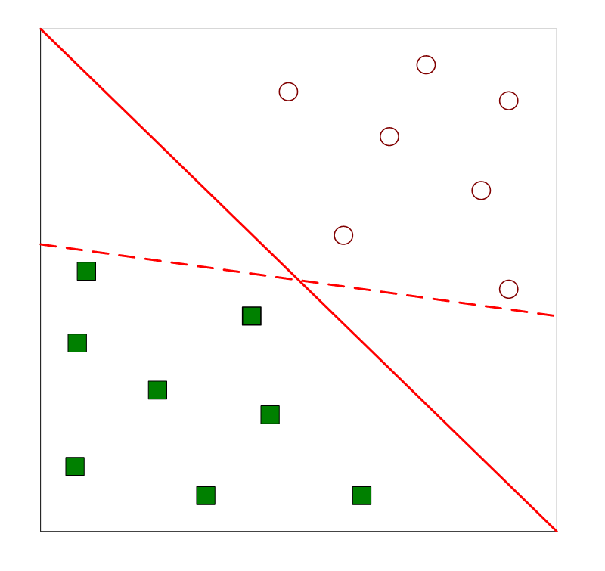
Support Vector Machines
Which one is better?

Slide 63
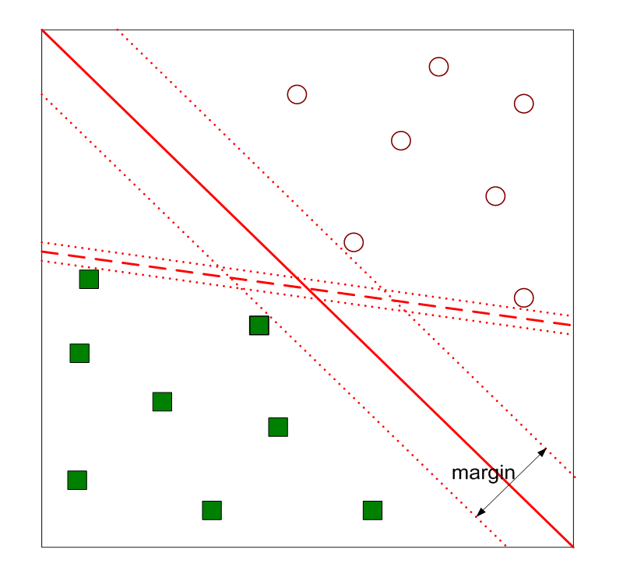
Support Vector Machines
Want the hyperplane with the
maximal margin

Slide 64
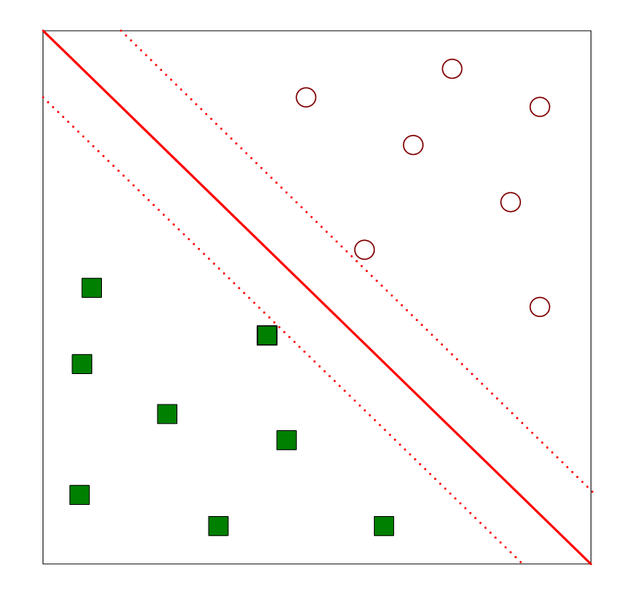
Support Vector Machines
Want the hyperplane with the
maximal margin
How can we find this hyperplane?

Slide 65
Support Vector Machines

Slide 66
Support Vector Machines

Slide 67
Support Vector Machines

Slide 68
Support Vector Machines

Slide 69
Support Vector Machines

Slide 70
Support Vector Machines

Slide 71
Support Vector Machines

Slide 72
Support Vector Machines

Slide 74
Want to maximize this
subject to these constraints
Karush-Kuhn-Tucker Theorem

Slide 75
Karush-Kuhn-Tucker Theorem
Kuhn, H.W. and Tucker, A.W. (1951). "Nonlinear Programming". Proceedings of 2nd Berkeley Symposium. pp. 481–492.
Derivations of SVM's
Cortes, C. and Vapnik, V. (1995). "Support Vector Networks". Machine Learning, 20, p. 273—297.

Slide 76
Key Results

Slide 77
Today's Topics
Soft Margin Support Vector Machines
Nonlinear Support Vector Machines
Kernel Methods

Slide 78
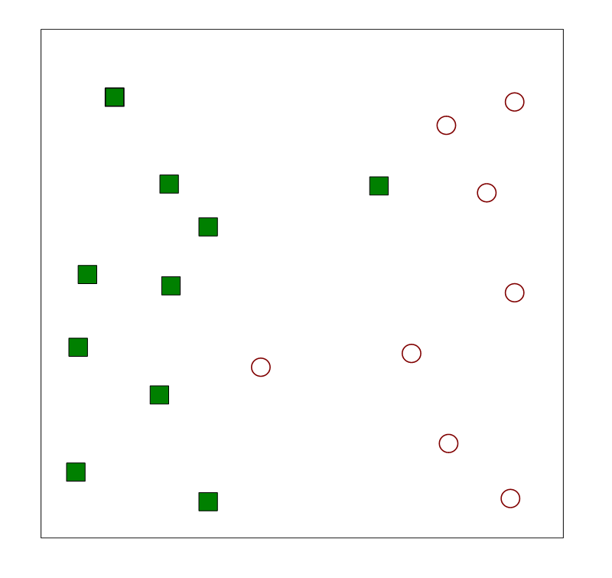
Soft Margin SVM
Allows points to be on the wrong side of hyperplane
Uses slack variables

Slide 79
Soft Margin SVM
Want to minimize this

Slide 81
Soft Margin SVM

Slide 82
Relationship Between Soft and Hard Margins

Slide 83
Relationship Between Soft and Hard Margins

Slide 84
Relationship Between Soft and Hard Margins

Slide 85
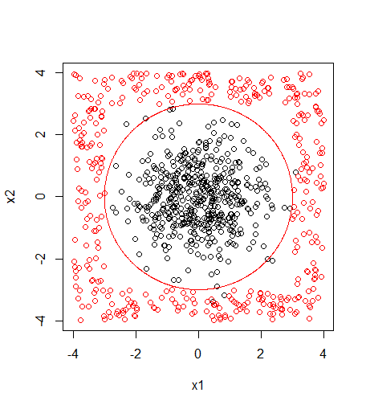
Nonlinear SVM

Slide 86
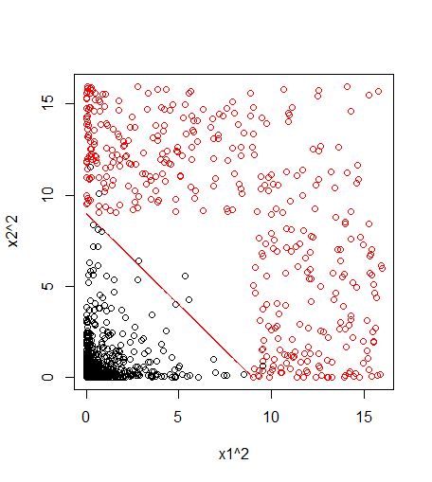
Nonlinear SVM

Slide 87
Nonlinear SVM
Can be computationally
expensive

Slide 88
Kernel Trick

Slide 89
Kernels

Slide 90
Kernels

Slide 91
Today's Topics
Neural Networks

Slide 92
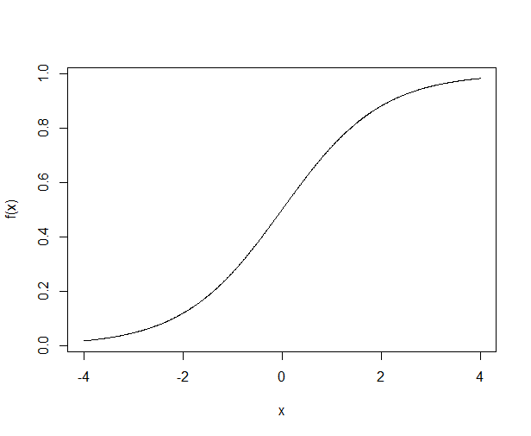
The Logistic Function

Slide 93
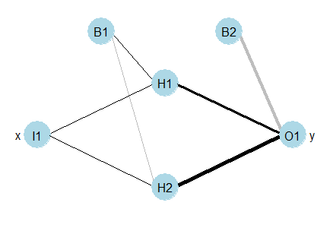
Neural Networks

Slide 94
Neural Networks

Slide 95
Neural Networks

Slide 96
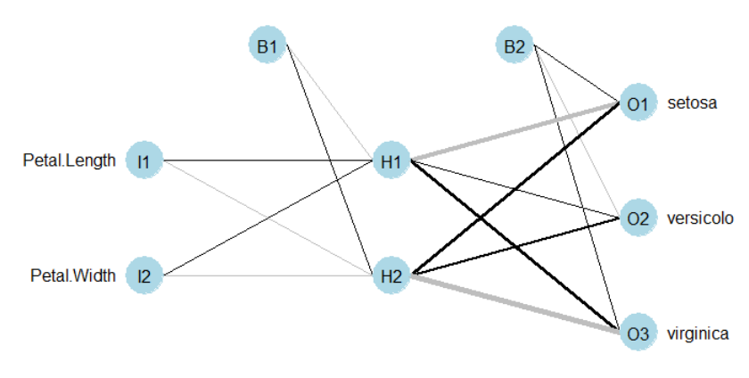
Probabilities
This flower would be
classified as setosa

Slide 97
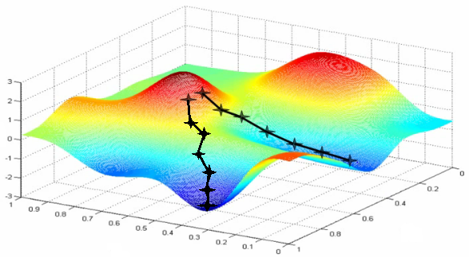
Gradient Descent

Slide 98
Gradient Descent for Multiple Regression Models

Slide 99
Neural Network (Perceptron)

Slide 100
Gradient for Neural Network

Slide 101
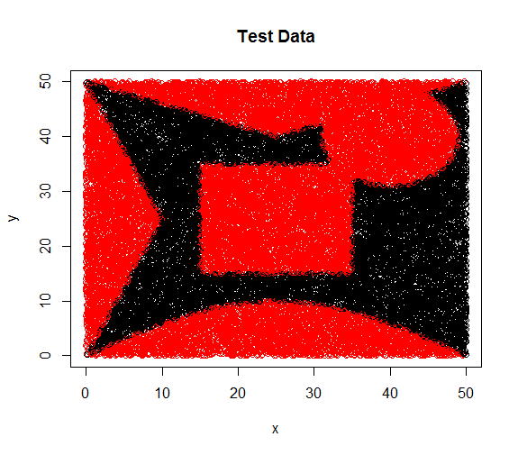
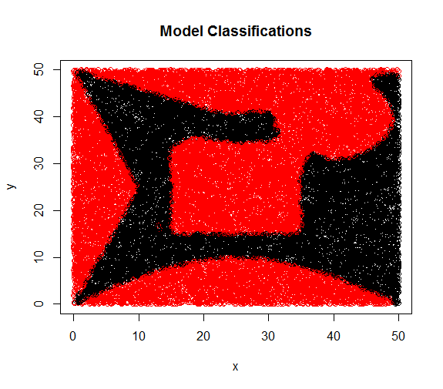
Neural network with one hidden layer
30 neurons in hidden layer
Classification accuracy = 98.7%

Slide 102
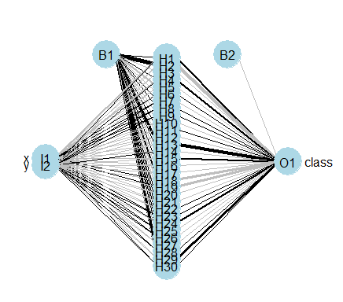
Two-layer Neural Networks
Two-layer Neural Network (One hidden layer)
A two-layer neural network with sigmoid (logistic) activation functions can model any decision boundary

Slide 103
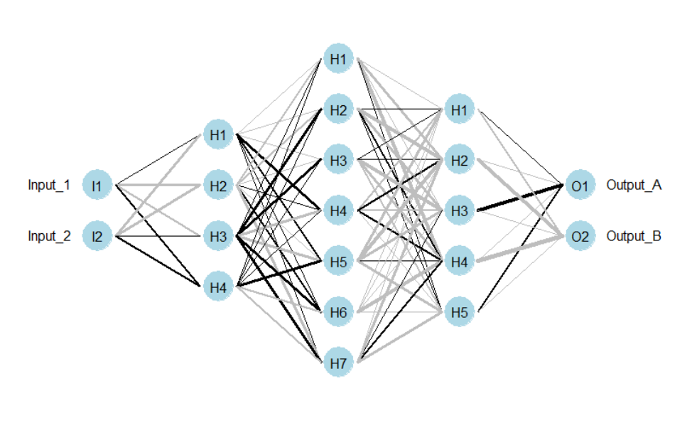
Multi-layer Perceptron
91% Accuracy

Slide 104
Gradient Descent for Multi-layer Perceptron
Error Back Propagation Algorithm
At each iteration
Feed inputs forward through the neural network using current weights.
Use a recursion formula (back propagation) to obtain the gradient with respect to all weights in the neural network.
Update the weights using gradient descent.

Slide 105
Today's Topics
Ensemble Methods
Bagging
Random Forests
Boosting

Slide 106
Ensemble Methods

Slide 107
Bagging (Bootstrap Aggregating)

Slide 108
Random Forests
Uses Bagging
Uses Decision Trees
Features used to split decision tree are randomized

Slide 109
Boosting
Idea:
Create classifiers sequentially
Later classifiers focus on mistakes of previous classifiers

Slide 110
Boosting
Idea:
Create classifiers sequentially
Later classifiers focus on mistakes of previous classifiers

Slide 111
Boosting
Idea:
Create classifiers sequentially
Later classifiers focus on mistakes of previous classifiers

Slide 112
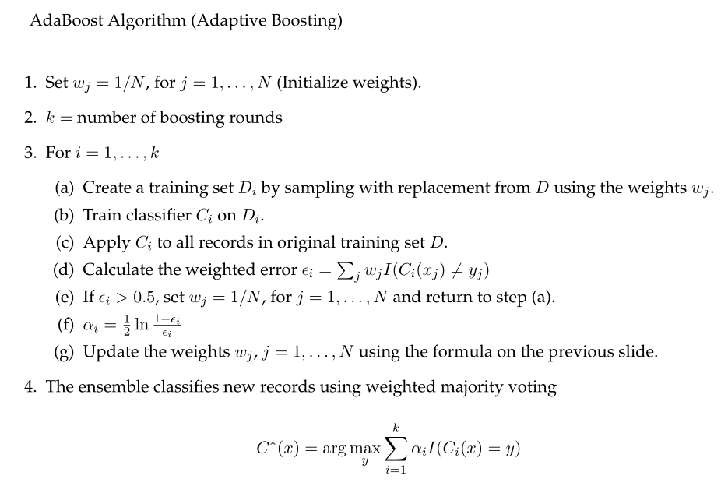

Slide 113
Today's Topics
The Multiclass Problem
One-against-one approach
One-against-rest approach

Slide 114
The Multiclass Problem
Binary dependent variable y: Only two possible values
Multiclass dependent variable y: More than two possible values
How can we deal with multiclass variables?

Slide 115
Classification Algorithms
Decision Trees
k-Nearest Neighbors
Naïve Bayes
Neural Networks
Support Vector Machines
How can we extend SVM to multiclass problems?
How can we extend other algorithms to multiclass problems?
Deals with multiclass
output by default
Only deals with binary
classification problems

Slide 116
Classification Algorithms
Decision Trees
k-Nearest Neighbors
Naïve Bayes
Neural Networks
Support Vector Machines
How can we extend SVM to multiclass problems?
How can we extend other algorithms to multiclass problems?
Deals with multiclass
output by default
Only deals with binary
classification problems

Slide 117
One-against-one Approach

Slide 118
One-against-one Approach

Slide 119
One-against-rest Approach

